Slide 1
The Abstract Windowing Toolkit
Since Java was first released, its user interface facilities have been a significant weakness
  The Abstract Windowing Toolkit (AWT) was part of the JDK form the beginning, but it really was not sufficient to support a complex user interface
JDK 1.1 fixed a number of problems, and most notably, it introduced a new event model. It did not make any major additions to the basic components

Slide 2
Java Foundation Classes
In April 1997, JavaSoft announced the Java Foundation Classes (JFC).
  a major part of the JFC is a new set of user interface components called Swing.
AWT
Swing
Accessibility
Java
2D
Drag
And
Drop

Slide 3
Swing
The Swing classes are used to build GUIs
  Swing does not stand for anything
  Swing is built on top of the 1.1/1.2 AWT libraries
Swing makes 3 major improvements on the AWT
  does not rely on the platform’s native components
  it supports “Pluggable Look-and-Feel” or PLAF
  it is based on the Model-View-Controller (MVC)
JFC
AWT
JDK 1.2
Swing

Slide 4
GUI Packages
AWT
  java.awt
  java.awt.color
  java.awt.datatransfer
  java.awt.event
  java.awt.font
  java.awt.geom
  java.awt.image
  ...
Swing
  javax.accessibility
  javax.swing
  javax.swing.colorchooser
  javax.swing.event
  javax.swing.filechooser
  javax.swing.plaf
  javax.swing.table
  javax.swing.text.html
  javax.swing.tree
  ...

Slide 5
Components
A GUI consists of different graphic Component objects which are combined into a hierarchy using Container objects.
Component class
  An abstract class for GUI components such as menus, buttons, labels, lists, etc.
Container
  An abstract class that extends Component. Containers can hold multiple components.

Slide 6
Weighing Components
Sun makes a distinction between lightweight and heavyweight components
  Lightweight components are not dependent on native peers to render themselves. They are coded in Java.
  Heavyweight components are rendered by the host operating system. They are resources managed by the underlying window manager.

Slide 7
Heavyweight Components
Heavyweight components were unwieldy for two reasons
  Equivalent components on different platforms do not necessarily act alike.
  The look and feel of each component was tied to the host operating system
Almost all Swing components are lightweight except
  JApplet, JFrame, JDialog, and JWindow

Slide 8
Additional Swing Features
Swing also provides
  A wide variety of components (tables, trees, sliders, progress bars, internal frame, …)
  Swing components can have tooltips placed over them.
  Arbitrary keyboard events can be bound to components.
  Additional debugging support.
  Support for parsing and displaying HTML based information.

Slide 9
Applets versus Applications
Using Swing it is possible to create two different types of GUI programs
  Standalone applications
    Programs that are started from the command line
    Code resides on the machine on which they are run
  Applets
    Programs run inside a web browser
    Code is downloaded from a web server
    JVM is contained inside the web browser
    For security purposes Applets are normally prevented from doing certain things (for example opening files)
For now we will write standalone applications

Slide 10
Three Types of GUI Classes
Containers
  JFrame, JPanel, JApplet
Components
  JButton, JTextField, JComboBox, JList, etc.
Helpers
  Graphics, Color, Font, Dimension, etc.

Slide 11
JFrames
A JFrame is a Window with all of the adornments added.
  JFrame inherits from Frame, Window, Container, Component, and Object
A JFrame provides the basic building block for screen-oriented applications.
JFrame win = new JFrame( “title” );

Slide 12
Creating a JFrame
import javax.swing.*;
public class SwingFrame {
public static void main( String args[] ) {
JFrame win = new JFrame( "My First GUI Program" );
win.setVisible(true);
}
} // SwingFrame

Slide 13
JFrame
Sizing a Frame
  You can specify the size
    Height and width given in pixels
    The size of a pixel will vary based on the resolution of the device on which the frame is rendered
    Usually one uses an instance of the Dimension class.
  The method pack() will set the size of the frame automatically, based on the size of the components contained in the content pane
    Note that pack does not look at the title bar
    Sometimes pack() does not work as you might expect; try it and see.

Slide 14
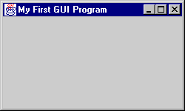
Creating a JFrame
import javax.swing.*;
import java.awt.*;
public class SwingFrame {
static Dimension windowSize = new Dimension( 250, 150 );
public static void main( String args[] ) {
JFrame win = new JFrame( "My First GUI Program" );
win.setDefaultCloseOperation( JFrame.EXIT_ON_CLOSE );
win.setSize( windowSize );
win.setVisible(true);
}
} // SwingFrame

Slide 15
JFrame
Layered pane
JFrames have several panes:
Components are placed in the Content Pane
Glass pane
Menu bar
Content pane

Slide 16
Swing Components
JComponent
  JComboBox, JLabel, JList, JMenuBar, JPanel, JPopupMenu, JScrollBar, JScrollPane, JTable, JTree, JInternalFrame, JOptionPane, JProgressBar, JRootPane, JSeparator, JSlider, JSplitPane, JTabbedPane, JToolBar, JToolTip, Jviewport, JColorChooser, JTextComponent, …

Slide 17
JLabels
JLabels are components that you can fill with text.
When creating a label you can specify the initial value and the alignment you wish to use within the label.
You can use getText() and setText() to get and change the value of the label.
lbl = new JLabel( ”text", JLabel.RIGHT );

Slide 18

Hello World
import javax.swing.*;
public class SwingFrame {
public static void main( String args[] ) {
JFrame win = new JFrame( "My First GUI Program" );
JLabel label = new JLabel( "Hello World" );
win.getContentPane().add( label );
win.setVisible(true);
}
} // SwingFrame

Slide 19
JButtons
JButton extends Component , displays a string, and delivers an ActionEvent for each mouse click.
Normally buttons are displayed with a border
In addition to text, JButtons can also display icons
button = new JButton( ”text“ );

Slide 20

Buttons
import javax.swing.*;
public class SwingFrame {
public static void main( String args[] ) {
JFrame win = new JFrame( "My First GUI Program" );
JButton button = new JButton( "Click Me!!" );
win.getContentPane().add( button );
win.setVisible(true);
}
} // SwingFrame

Slide 21
Layout Manager
Layout Manager
  An interface that defines methods for positioning and sizing objects within a container. Java defines several default implementations of LayoutManager.
Geometrical placement in a Container is controlled by a LayoutManager object

Slide 22
Components, Containers, and Layout Managers
Containers may contain components (which means containers can contain containers!!).
All containers come equipped with a layout manager which positions and shapes (lays out) the container's components.
Much of the action in Swing occurs between components, containers, and their layout managers.

Slide 23
Layout Managers
Layouts allow you to format components on the screen in a platform-independent way
The standard JDK provides many classes that implement the LayoutManager interface, including:
  FlowLayout
  GridLayout
  BorderLayout
  BoxLayout
  CardLayout
  OverlayLayout
  GridBagLayout

Slide 24
Changing the Layout
To change the layout used in a container you first need to create the layout.
Then you invoke the setLayout() method on the container to use the new layout.
The layout manager should be established before any components are added to the container
JPanel p = new JPanel() ;
p.setLayout( new FlowLayout() );

Slide 25
FlowLayout
FlowLayout is the default layout for the JPanel class.
When you add components to the screen, they flow left to right (centered) based on the order added and the width of the screen.
Very similar to word wrap and full justification on a word processor.
If the screen is resized, the components' flow will change based on the new width and height

Slide 26
Flow Layout
import javax.swing.*;
import java.awt.*;
public class ShowFlowLayout {
public static void main( String args[] ) {
JFrame win = new JFrame( "My First GUI Program" );
win.setDefaultCloseOperation( JFrame.EXIT_ON_CLOSE );
win.getContentPane().setLayout( new FlowLayout() );
for ( int i = 0; i < 10; i++ ) {
win.getContentPane().add(
new JButton( String.valueOf( i ) ) );
}
win.setVisible(true);
}
} // ShowFlowLayout

Slide 27

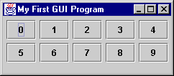
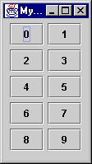
FlowLayout

Slide 28
GridLayout
Arranges components in rows and columns
  If the number of rows is specified
    columns = number of components / rows
  If the number of columns is specified
    Rows = number of components / columns
  The number of columns is ignored unless the number of rows is zero.
The order in which you add components matters
  Component 1 → (0,0), Component 2 → (0,1), …...
Components are resized to fit the row-column area

Slide 29
Grid Layout
import javax.swing.*;
import java.awt.*;
public class ShowGridLayout {
public static void main( String args[] ) {
JFrame win = new JFrame( "My First GUI Program" );
win.setDefaultCloseOperation( JFrame.EXIT_ON_CLOSE );
win.getContentPane().setLayout( new GridLayout( 2, 0 ) );
for ( int i = 0; i < 10; i++ ){
win.getContentPane().add(
new JButton( String.valueOf( i ) ) );
}
win.setVisible(true);
}
} // ShowGridLayout

Slide 30

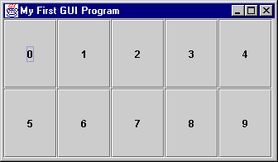
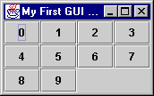
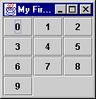
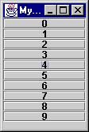
GridLayout
gridLayout( 2, 4 )
gridLayout( 0, 4 )
gridLayout( 4, 4 )
gridLayout( 10, 10 )

Slide 31
BoxLayout
BoxLayout provides an easy way to lay out components horizontally or vertically.
Components are added in order.
BoxLayout attempts to arrange components at their
  preferred widths (for horizontal layout) or
  preferred heights (for vertical layout).
Static methods in Box class are available for “glue” and “struts.”

Slide 32
BoxLayout example
import javax.swing.*;
import java.awt.*;
public class ShowBoxLayout {
public static void main( String args[] ) {
JFrame win = new JFrame( "My First GUI Program" );
win.setDefaultCloseOperation( JFrame.EXIT_ON_CLOSE );
win.getContentPane().setLayout(
new BoxLayout( win.getContentPane(), BoxLayout.X_AXIS ) );
for ( int i = 0; i < 10; i++ ){
win.getContentPane().add( new JButton( String.valueOf( i ) ) );
win.getContentPane().add( Box.createHorizontalGlue() );
}
win.pack();
win.setVisible(true);
}
} // ShowBoxLayout

Slide 33

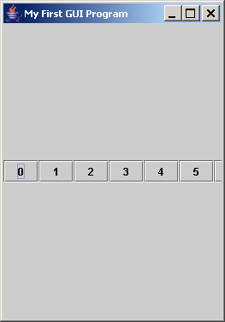
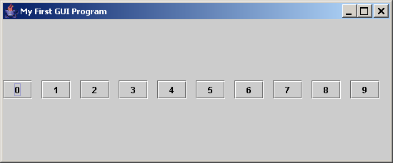
BoxLayout
Note that components retain their preferred size.

Slide 34
BorderLayout
BorderLayout provides 5 areas to hold components. These are named after the four different borders of the screen, North, South, East, West, and Center.
When a Component is added to the layout, you must specify which area to place it in. The order in which components are added is not important.
The center area will always be resized to be as large as possible

Slide 35
BorderLayout
import javax.swing.*;
import java.awt.*;
public class ShowBorderLayout {
public static void main( String args[] ) {
JFrame win = new JFrame( "My First GUI Program" );
win.setDefaultCloseOperation( JFrame.EXIT_ON_CLOSE );
Container content = win.getContentPane();
content.setLayout( new BorderLayout() );
content.add( BorderLayout.NORTH, new JButton( "North" ) );
content.add( "South", new JButton( "South" ) );
content.add( "East", new JButton( "East" ) );
content.add( "West", new JButton( "West" ) );
content.add( "Center", new JButton( "Center" ) );
win.setVisible(true);
}
} // ShowBorderLayout

Slide 36
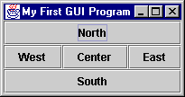
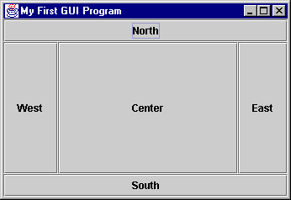
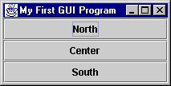
BorderLayout

Slide 37
Containers
A JFrame is not the only type of container that you can use in Swing
The subclasses of Container are:
  JPanel
  JWindow
  JApplet
Window is subclassed as follows:
  JDialog
  JFrame

Slide 38
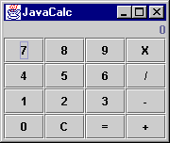
A Simple 4 Function Calculator

Slide 39
Swing Components
JFrame
with BorderLayout
JLabel
JButton
JPanel
with GridLayout

Slide 40
CalcGui.java (pg. 1)
import javax.swing.*;
import java.awt.*;
import java.awt.event.*;
public class CalcGui implements {
// Labels for the buttons
private static final String labels = "789X456/123-0C=+";
private static final int NUMROWS = 4;
private static final int NUMCOLS = 4;
private JLabel display; // The display
public CalcGui( String name ) {
// A Frame for the calculator
JFrame win = new JFrame(name);

Slide 41
CalcGui.java (pg. 2)
// Create the button panel
JPanel buttons = new JPanel();
buttons.setLayout(new GridLayout(NUMROWS, NUMCOLS));
JButton b;
for ( int i = 0 ; i < labels.length() ; i++ ) {
b = new JButton( labels.substring( i, i + 1 ) );
buttons.add( b );
}
// Create the display
display = new JLabel( "0", JLabel.RIGHT );
display.setFont( new Font( "Courier", Font.BOLD, 24 ) );

Slide 42
CalcGui.java (pg. 3)
// "Assemble" the calculator
Container content = win.getContentPane();
content.setLayout( new BorderLayout() );
content.add( "North", display );
content.add( "Center", buttons );
// Display it and let the user run with it :-)
win.pack();
win.setVisible(true);
}

